Slide 1


Ingestion of Common Microplastics by Hemigrapsus oregonensis
Do microplastics impact oxygen uptake in hairy shore crabs and/or accumulate in their gills and tissues?
H (0): No impact of oxygen uptake and microplastics will not accumulate
H (a): Decreased oxygen uptake and microplastic accumulation in gut and gills
n = 10
n = 10
Group #1 - MPs & food
Group #2 - MPs alone
Jarred crabs in two groups, microplastics scented with oyster material before feeding. End of study dissections to locate microplastic accumulation, blood assays to test lactate, BCA protein.

Slide 2
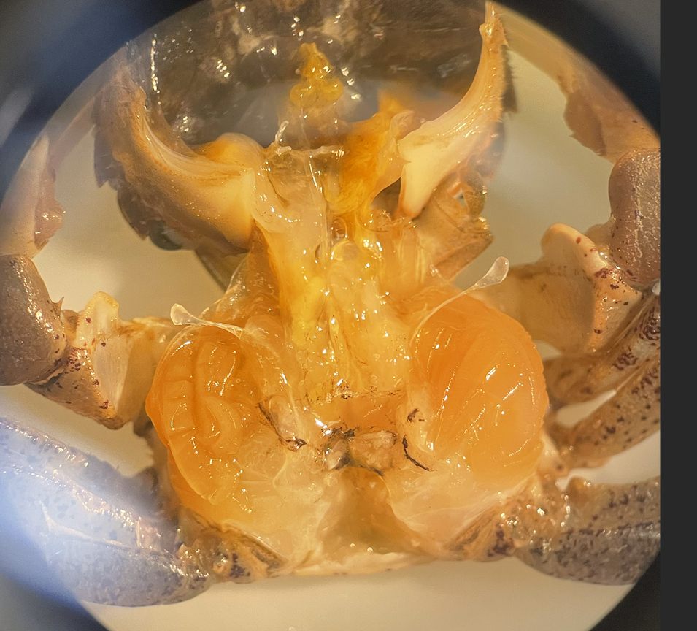
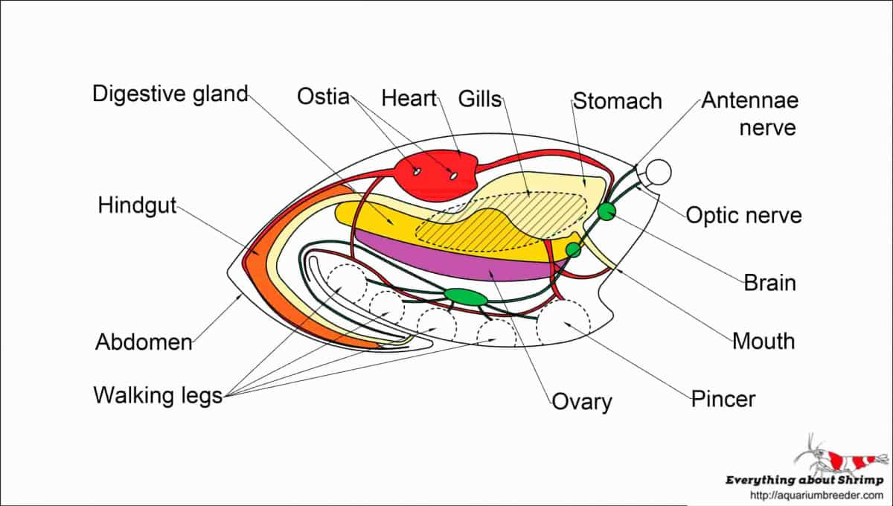
Stomach
Gills
Hindgut
No plastics found in either groups:
BCA and lactate will be compared with t-test to control groups.
88% mortality in fed group (1 survivor)
Will use BCA and lactate levels as a discussion point, without significance

